Slide 1
ELE 659
Midterm Project
ANC filtered X LMS algorithm
Mustafa Oztoprak
Z1883688

Slide 2
Off-line Training
% white noise signal,
x_noise=randn(1,T);
y_d=filter(S_z,S_p, x_noise);
% Off-line training
Shx=zeros(1,L); % the state of Sh(z)
Shz=zeros(1,L); % the weight of Sh(z)
e_z=zeros(1,T); % data buffer for the identification error
%Applying least mean square algorithm
mu=0.006; % learning rate
for k=1:T % discrete time k
Shx=[x_noise(k) Shx(1:L-1)]; % update the state
Shy=Shx*Shz'; % calculate output of Sh(z)
e_z(k)=y_d(k)-Shy; % calculate error
Shz=Shz+mu*Shx*e_z(k); % adjust the weight
end

Slide 3
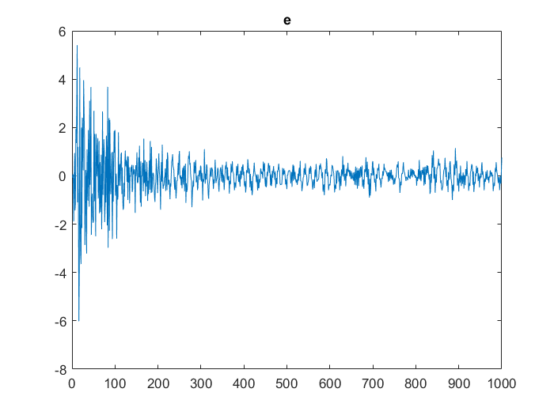
L=50,mu=0.01 Off-line Training

Slide 4
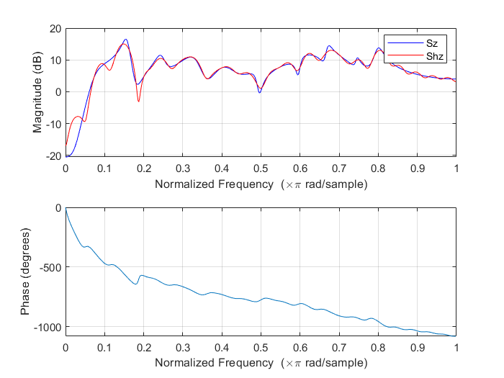
L=50,mu=0.01 Off-line Training

Slide 5
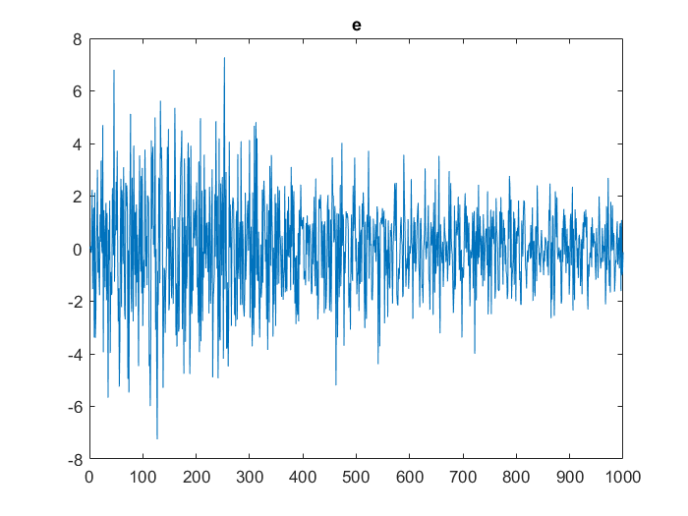
L=100,mu=0.01 Off-line Training

Slide 6
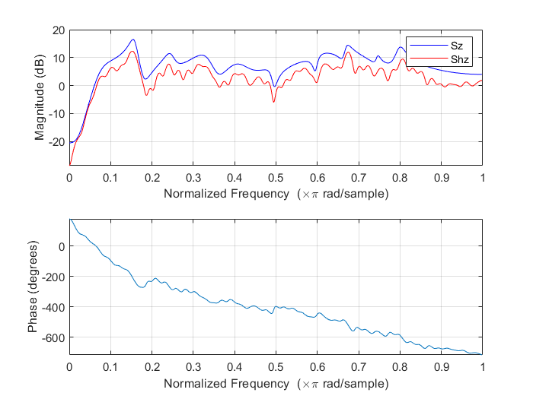
L=100,mu=0.01 Off-line Training

Slide 7
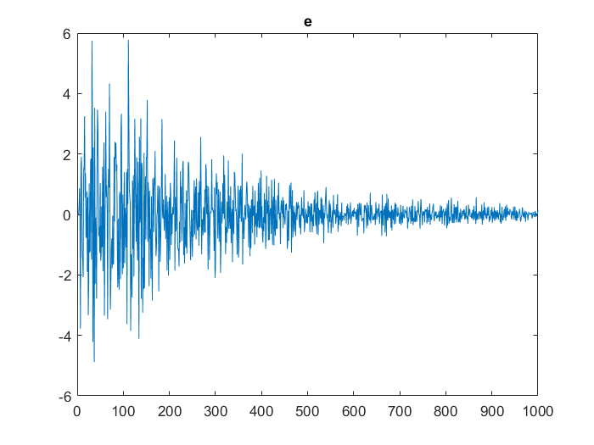
L=200,mu=0.006 Off-line Training

Slide 8
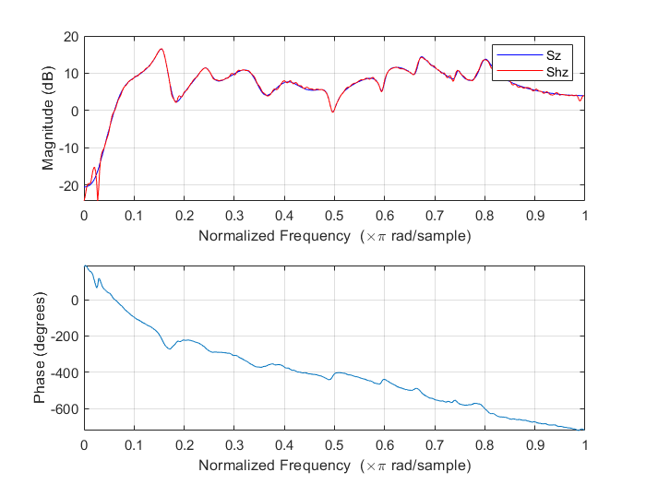
L=200,mu=0.006 Off-line Training

Slide 9
Online Training
X=SEC18R;
% and measure the arriving noise at the sensor position,
d=filter(P_z, P_p, X);
% Initiate the system,
Z = length(X);
xn = zeros(1,L);
y=zeros(1,L);
W = zeros(1,L);
e = zeros(1,Z);
X = filter(Shz,1,X) ; %xhat
mu1 =0.0000000003; %step size
%Real ANC part
for k=1:Z
xn = [X(k), xn(1:L-1)]; % update the state of xhat
y=xn*W'; % calculate output of yhat
e(k) = d(k)-y;% calculate error
W =W +mu1*xn*e(k); % adjust the weight
end

Slide 10
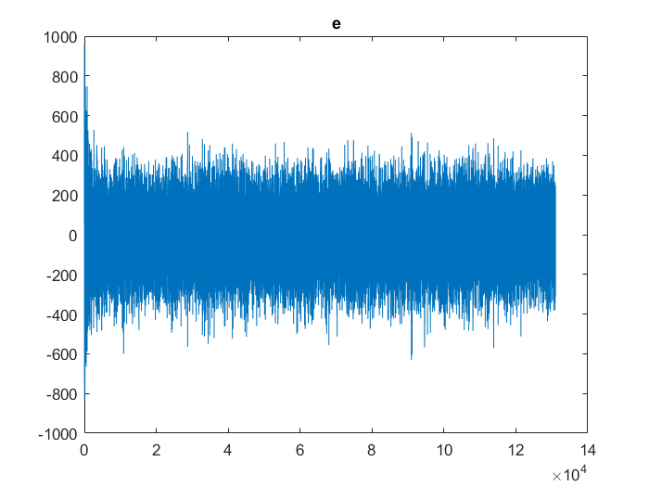
L=50,mu1= mu1=0.000000001; On-line Training

Slide 11
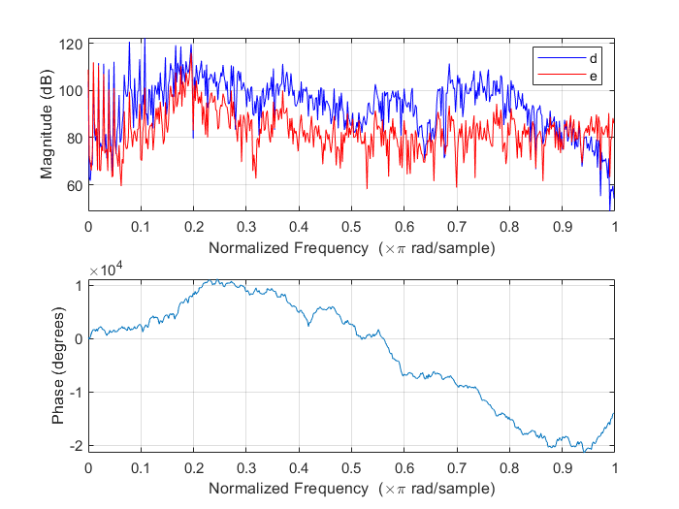
L=50,mu= mu1=0.000000001; On-line Training

Slide 12
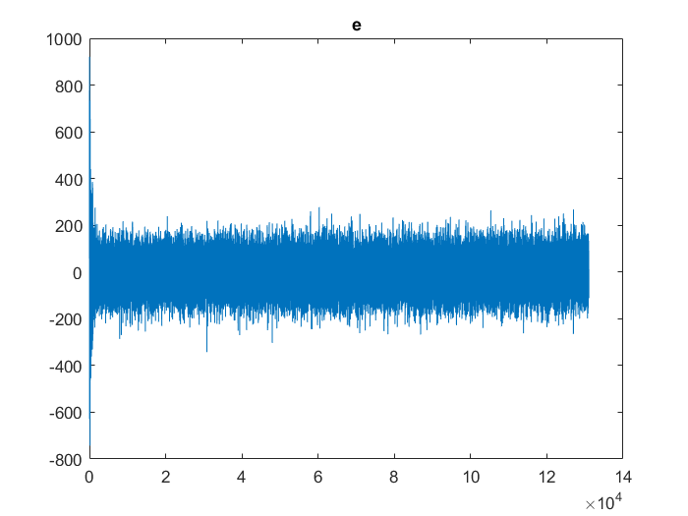
L=100, mu1=0.000000001; On-line Training

Slide 13
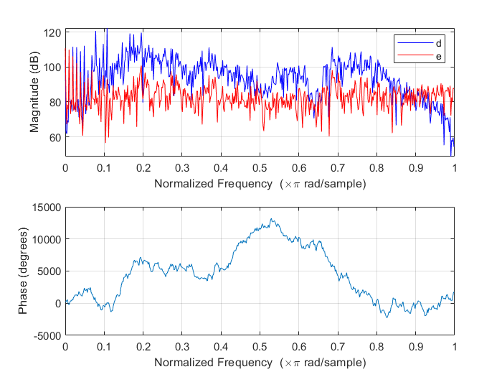
L=100, mu1=0.000000001; On-line Training

Slide 14
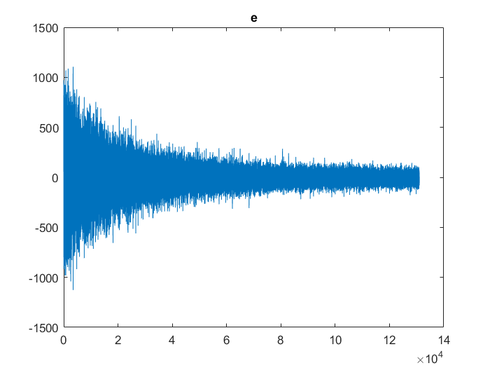
L=200, mu1 =0.0000000005; On-line Training

Slide 15
L=200, mu1 =0.0000000005; On-line Training

Slide 16
Discussion and analysis

